Slide 1
Position Based Fluids

Slide 2
Fluid Simulation Base on Particle System
SPH(Smoothed Particle Hydrodynamics)
Position Based Dynamics
Stable and Fast
Allow large time steps(>0.0016s)
Real-time calculation and rendering
For game
accuracy is not so important

Slide 3
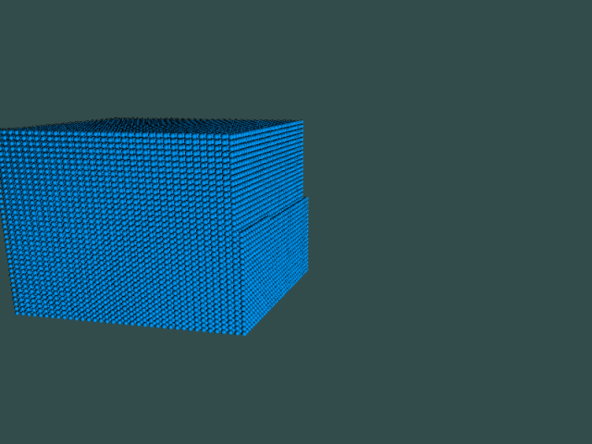
50k particles Dam Break/ 2 steps, 4 iterations / 45fps
Notes:
And two more videos

Slide 4
Implementation

Slide 5
Enforcing Incompressibility
SPH Density Estimator:
ρ: density
h: smoothing radius
p: position
i: the chosen particle
j: neighbors of I, neighbors are defined by smoothing raius ‘h’

Slide 6
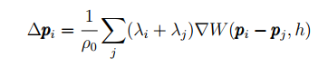
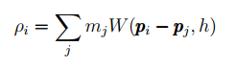
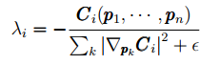
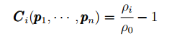
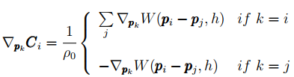
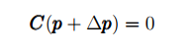
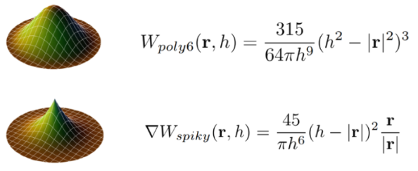
Enforcing Incompressibility
SPH Density Estimator:
Constrain:
SPH Kernel:

Slide 7
Implementation

Slide 8
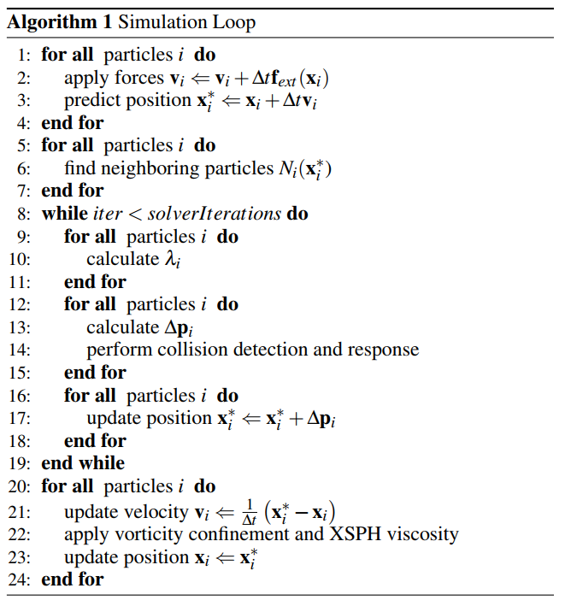
Parallelizable

Slide 9
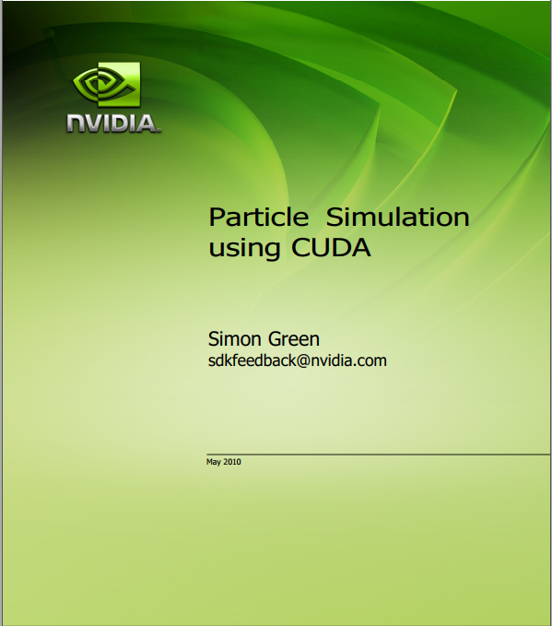
Particle System
OpenGL for rendering
CUDA 9.2 for parallelization computation

Slide 10
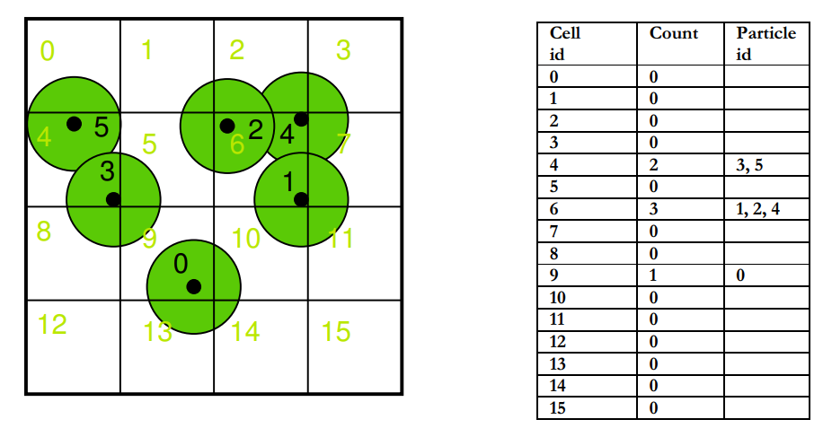
Particle System
Each Grid has its hash value

Slide 11
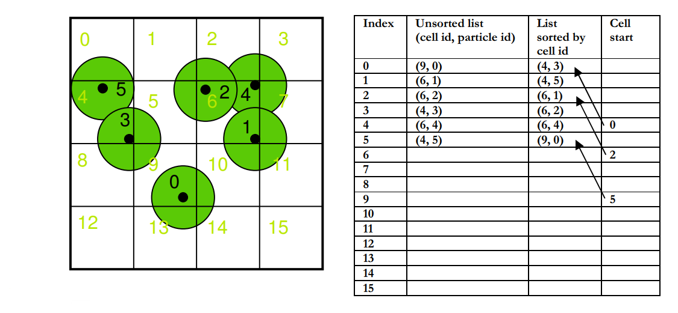
Particle System
Sorted Particle Index [number]
Sorted Cell start [number]
Sorted Cell end [number]
Using CUDPP library to do fast radix sort

Slide 12
Particle System
Limit maximum particle numbers in a Cell
Limit maximum neighbor number of a particle
Using AtomicAdd to do particle registering
Data Structure
Neighbors [number * maxNeighborsPerParticle ]
Neighbors_count [number]
Cells [grid_number*maxParticlesPerCell]
Cells_count [gird_number]

Slide 13
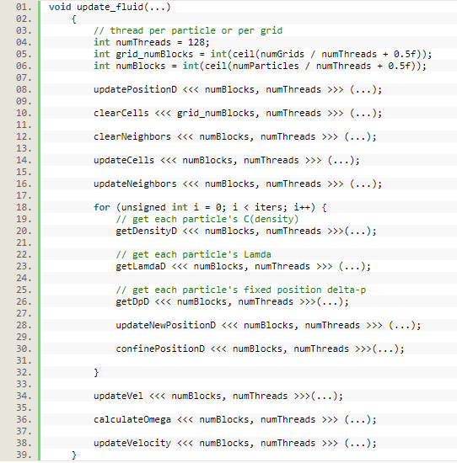
Parallel Computing

Slide 14
More

Slide 15
Tensile Instability
Introduce artificial pressure to solve the particle clamping problem

Slide 16
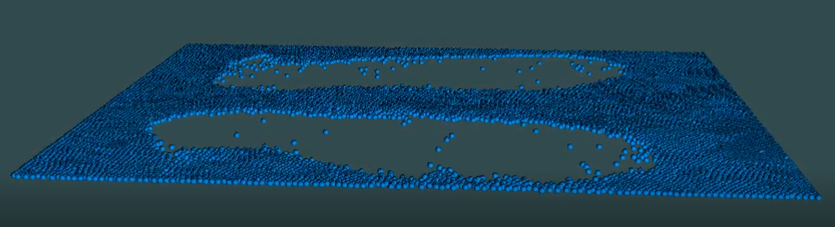

Slide 17
Vorticity Confinement And Viscosity
Vorticity confinement to replace lost energy:
XSPH viscosity for coherenet motion

Slide 18
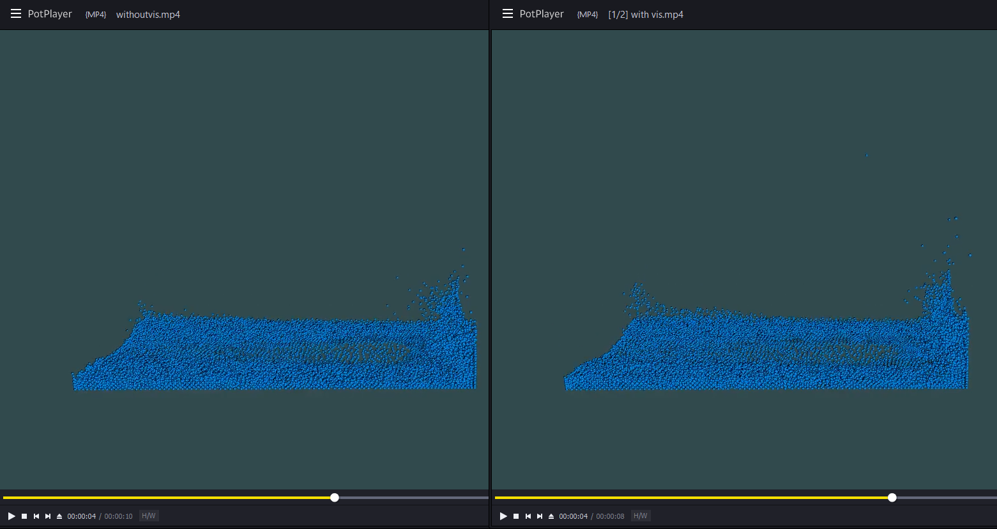

Slide 19
Explosion is not Art

Slide 20
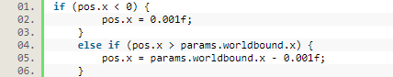
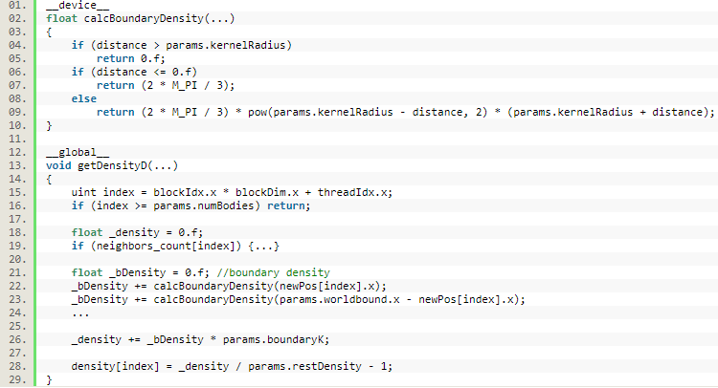
Introduce Bound Density
Using completely inelastic collision is not enough
Boundary Density to avoid particles squeezing in the corner

Slide 21
CFL Condition
CFL condition expresses that the distance that any information travels during the time step length within the mesh must be lower than the distance between mesh elements. In other words, information from a given cell or mesh element must propagate only to its immediate neighbors.
In Flex SDK

Slide 22
Sphere Drawing
In particle system, using mesh model to draw a sphere is too expensive.
Use Point Sprite
Use Fragment Shader to render the rectangle to be a circle
Use Phong Lighting Model to draw shadow on the circle to fool people’s eyes.

Slide 23
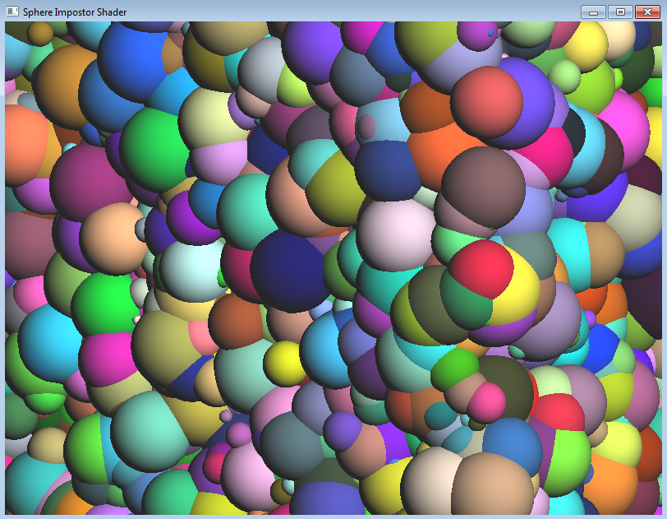
Sphere Drawing

Slide 24
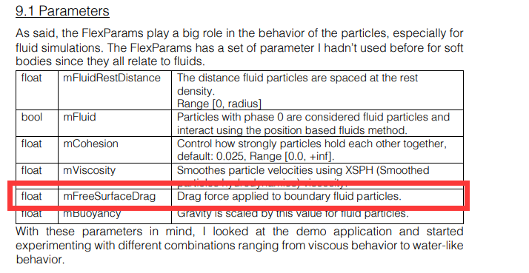
Parameters
The system’s performence is highly depended on parameters.
Search and try.
One paper is not enough:

Slide 25
Thank You

Slide 26
References
MACKLIN M., MÜLLER M.: Position based fluids. ACM Trans. Graph. 32, 4 (July 2013), 104:1–104:12. 5
Simon Green, Particle Simulation using CUDA, May 2010
MÜLLER M., HEIDELBERGER B., HENNIX M., RATCLIFF J.: Position based dynamics. Journal of Visual Communication and Image Representation 18, 2 (2007), 109–118. 2, 22

